Slide 1





1

Slide 2



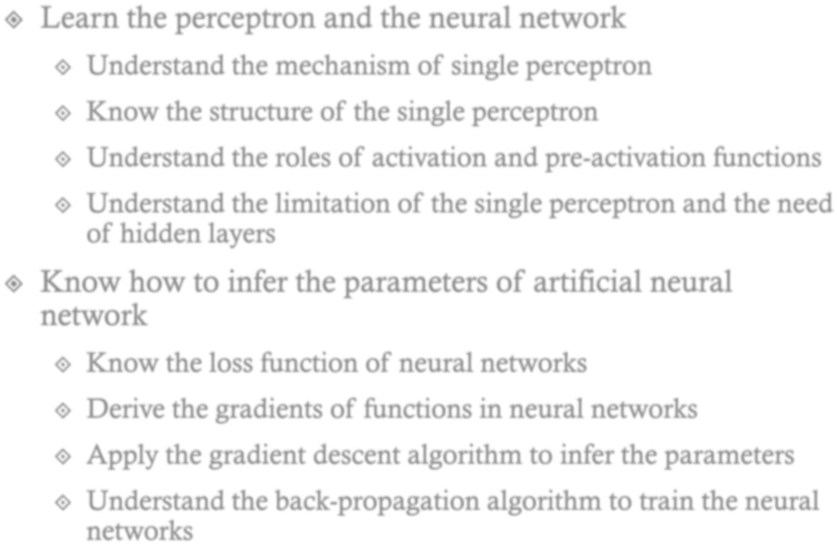








2

Slide 3

3

Slide 4
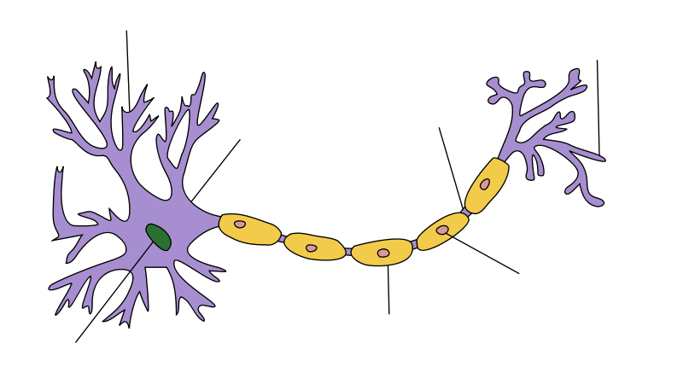



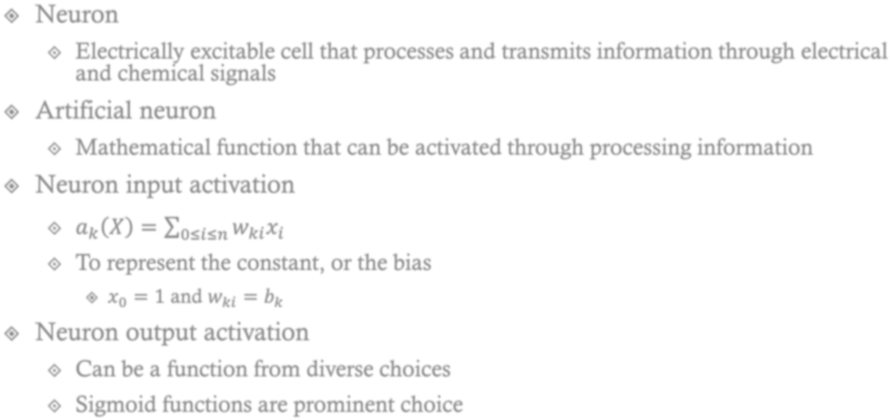













©Wikipedia
x₀
x₁
^{w}k0
k1
w
g(a_{k})
…….
a_{k}
y_{k}
w
k2
^{x}n-1
x_{n}
^{w}k3

Slide 5
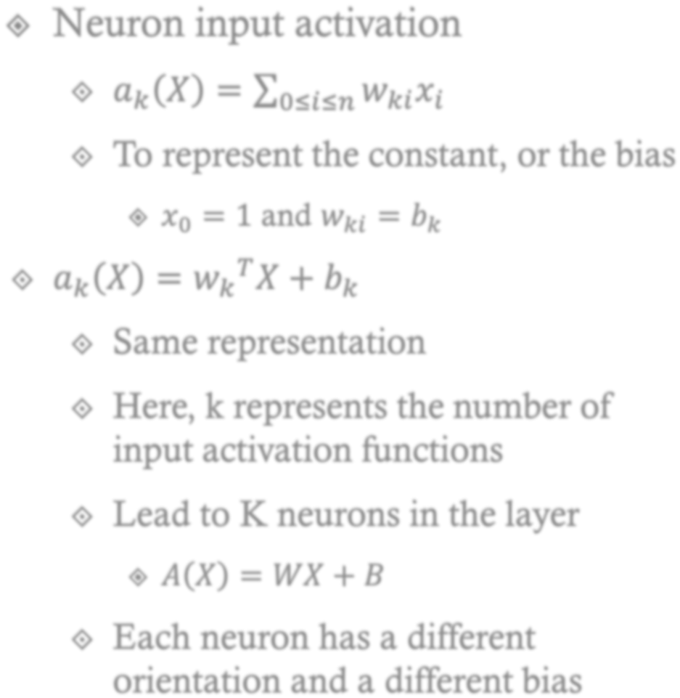




















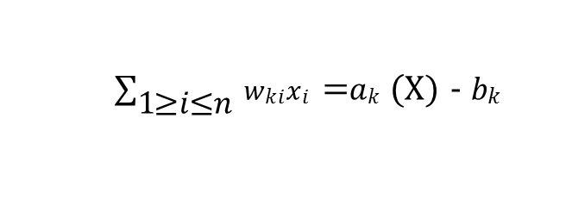
x₃
w
x₂
x₁
$\sum_{\text{1}\text{≤}\text{i}\text{≤}\text{n} }{\text{w}\text{ki}\text{x}\text{i}}$ _{𝑘}𝑎= (X) - 𝑏_{𝑘}
Adjusting the
Hyperplane orientation
Adjusting the hyperplane location

Slide 6
X | Y | XOR | AND (X,-Y) | AND (-X,Y) | AND(x,-y) OR AND(-x,y)
0 | 0 | 0 | 0 | 0 | 0
0 | 1 | 1 | 0 | 1 | 1
1 | 0 | 1 | 1 | 0 | 1
1 | 1 | 0 | 0 | 0 | 0
The sigmoid function shows the S-curve ranged and sharply adapted.
The output gets different by the orientation of the hyper plane
x₂
1
XOR
XOR
0
0
P(Y=y|X)
1
x₁
1
AND(x₁,-x₂)
1
0
X
Classify as y
Classify as y
0
0
1
AND(-x₁,x₂)

Slide 7
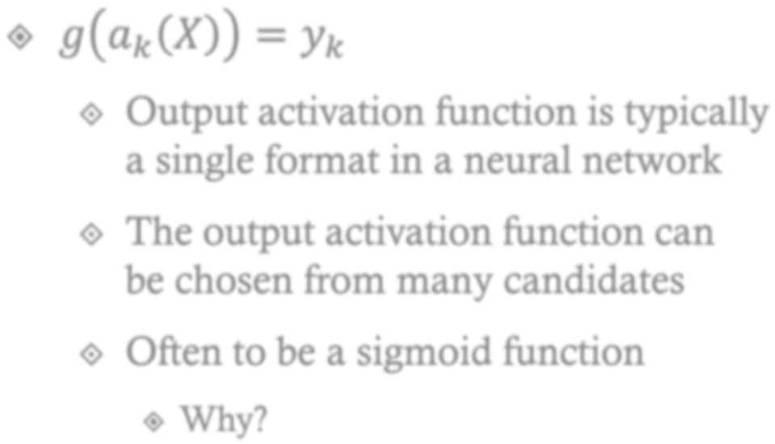










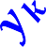


x₃
w
x₂
𝒂_{𝒌}
𝑿 − 𝒃_{𝒌}
x₁
෍ 𝑤_{𝑘𝑖}𝑥_{𝑖} = 𝑎_{𝑘} 𝑋 − 𝑏_{𝑘}
1≤𝑖≤𝑛
P(Y=y|X)
P(Y=y|X)
1
The sigmoid function shows the S-curve ranged and sharply adapted.
The output gets different by the orientation of the hyper plane
0
X
Classify as y
Classify as y
6

Slide 8





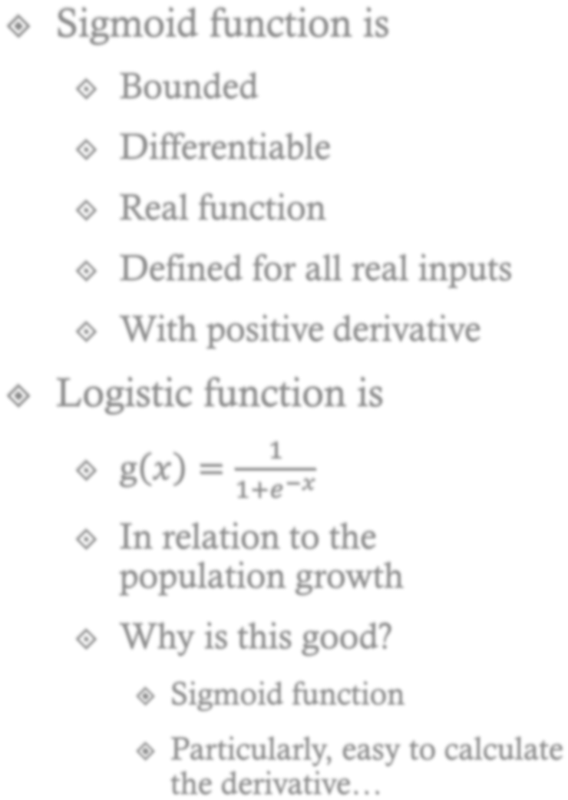


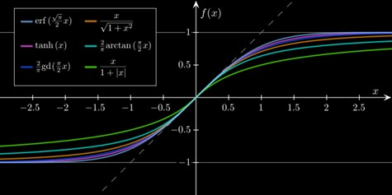








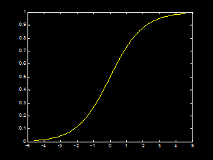
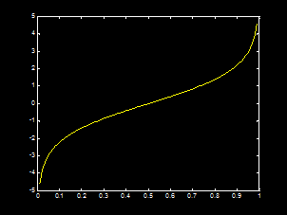






Neuron Output Activation Function: 𝒈 𝒂_{𝒌}
𝑿 = 𝒚_{𝒌}
Many types of sigmoid functions
7
Logistic Function
Logit Function, g 𝑥
= log(
𝑥
)
1−𝑥

Slide 9

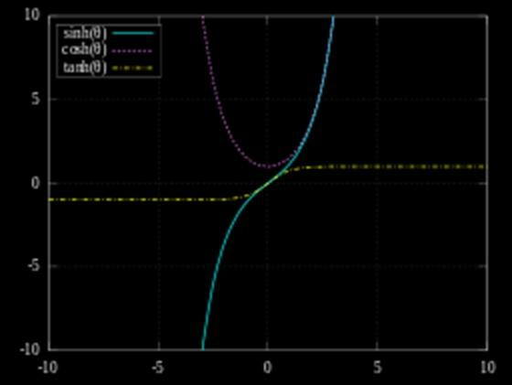
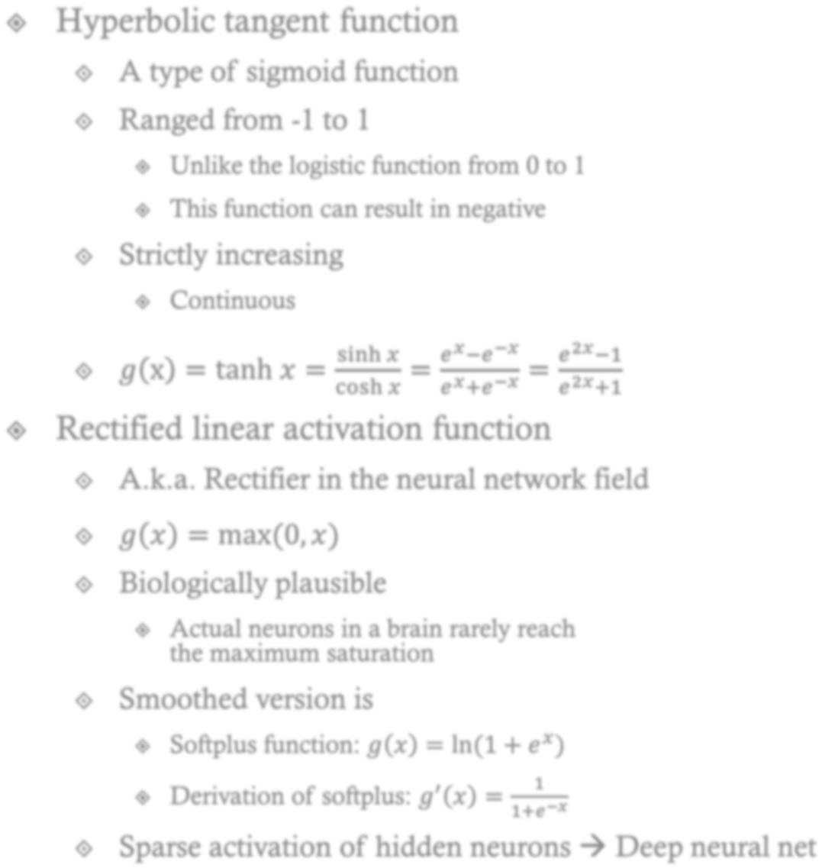



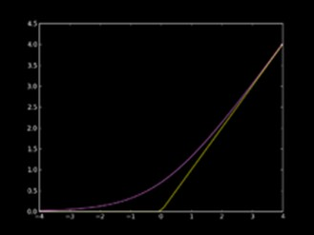
















Neuron Output Activation Function: 𝒈 𝒂_{𝒌} 𝑿
= 𝒚_{𝒌}
8

Slide 10
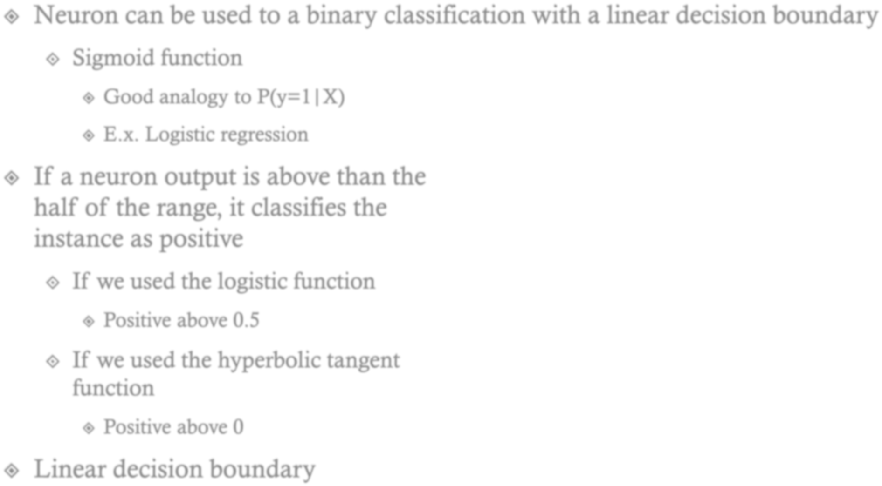












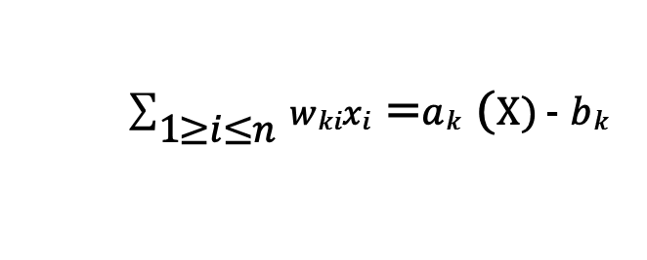
x₂
w
x₁
$\sum_{\text{1}\text{≤}\text{i}\text{≤}\text{n} }{\text{w}\text{ki}\text{x}\text{i}}$ _{𝑘}𝑎= (X) - 𝑏_{𝑘}
9

Slide 11
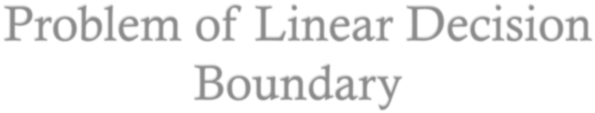


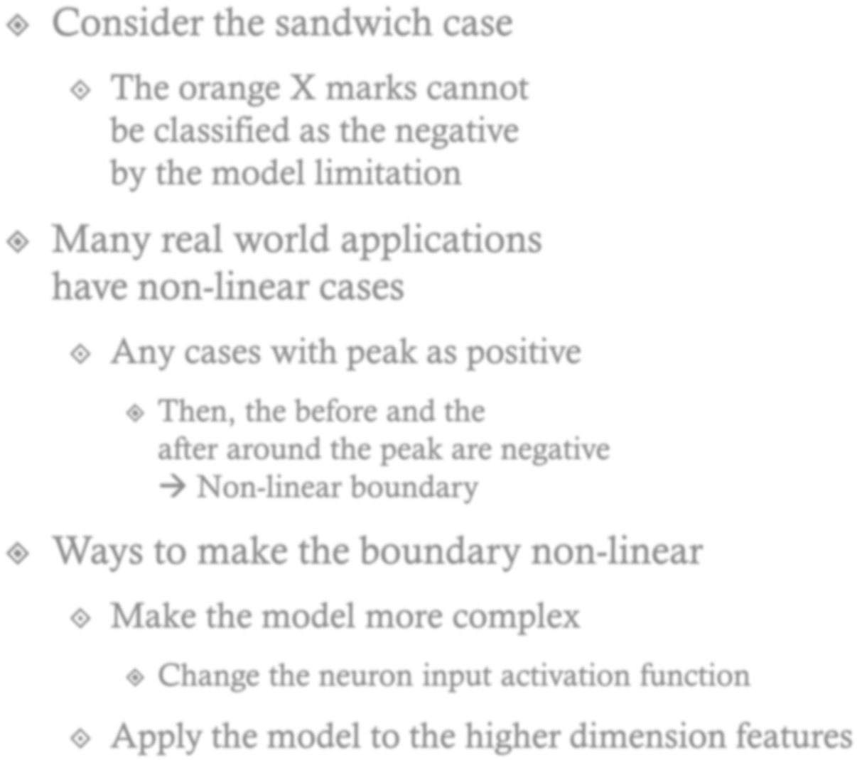












x₂
w
x₁
10

Slide 12






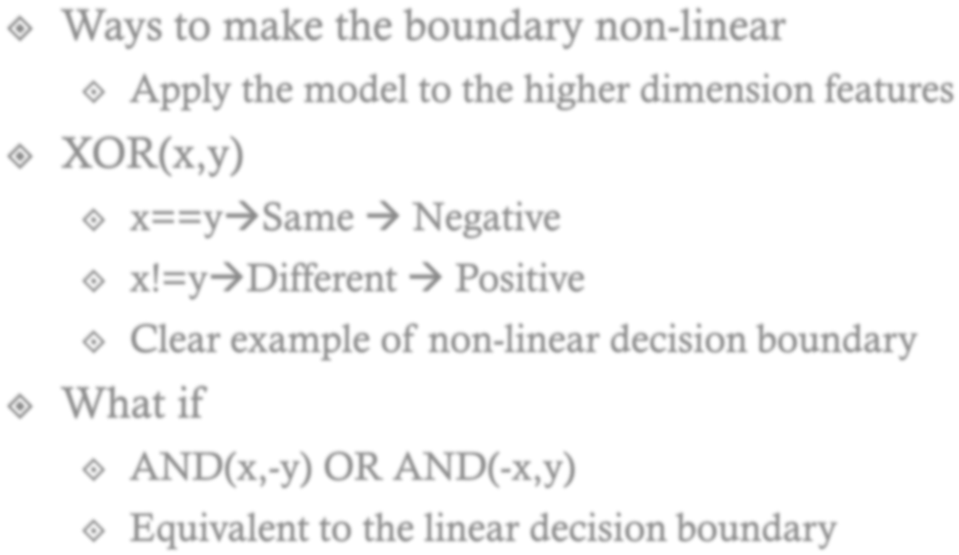





















x₂
1
XOR
0
0
AND(x₁,-x₂)
1
1
x₁
XOR
X | Y | XOR | AND (X,-Y) | AND (-X,Y) | AND(x,-y) OR AND(-x,y)
0 | 0 | 0 | 0 | 0 | 0
0 | 1 | 1 | 0 | 1 | 1
1 | 0 | 1 | 1 | 0 | 1
1 | 1 | 0 | 0 | 0 | 0
0
0
1
AND(-x₁,x₂)
11

Slide 13
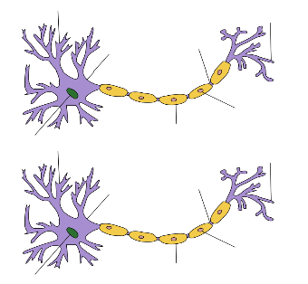



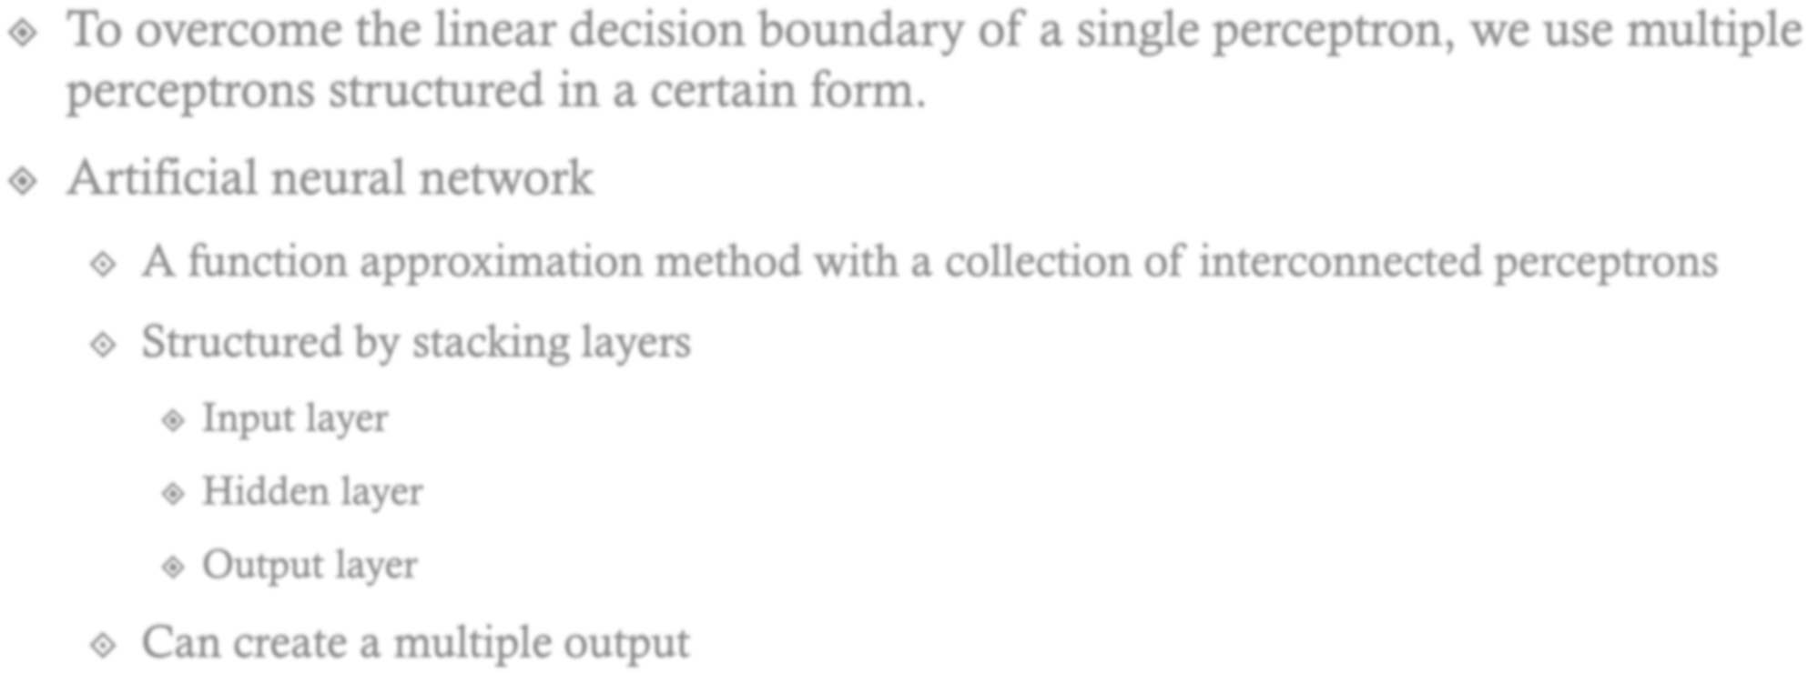








©Wikipedia
Input
Layer
Hidden
Layer
Output
Layer
1
b
w₁
x₁
𝑎 𝑋
= 𝑏 + 𝑤^{𝑇} 𝑥
𝑔(𝑎 𝑋 )
𝑦
…….
x_{n}
w_{n}
12

Slide 14




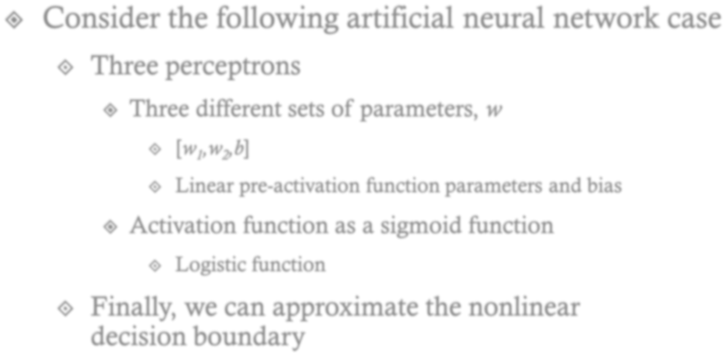








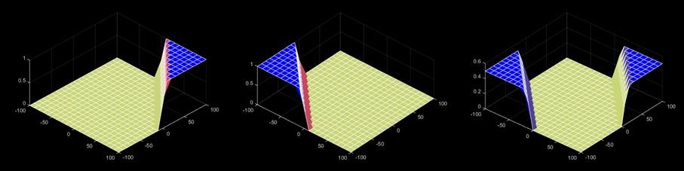
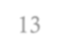
[0.5,0.5,-50]
[100,100,-100]
[-0.5,-0.5,50]
13

Slide 15
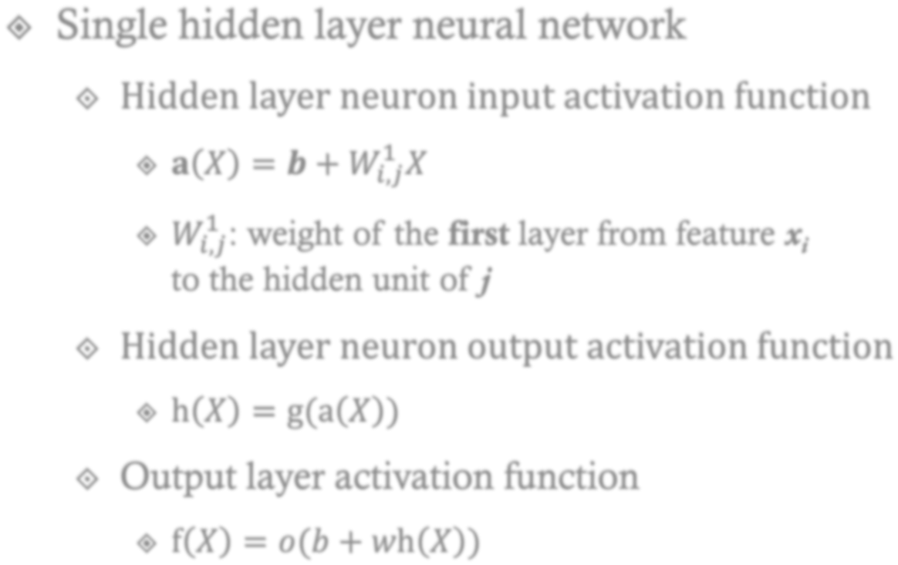

















x₀
x₁
^{w}k0
w
k1
g(a_{k})
…….
a_{k}
y_{k}
w
X₁
X₂
X₃
k2
^{x}n-1
x_{n}
^{w}k3
14

Slide 16
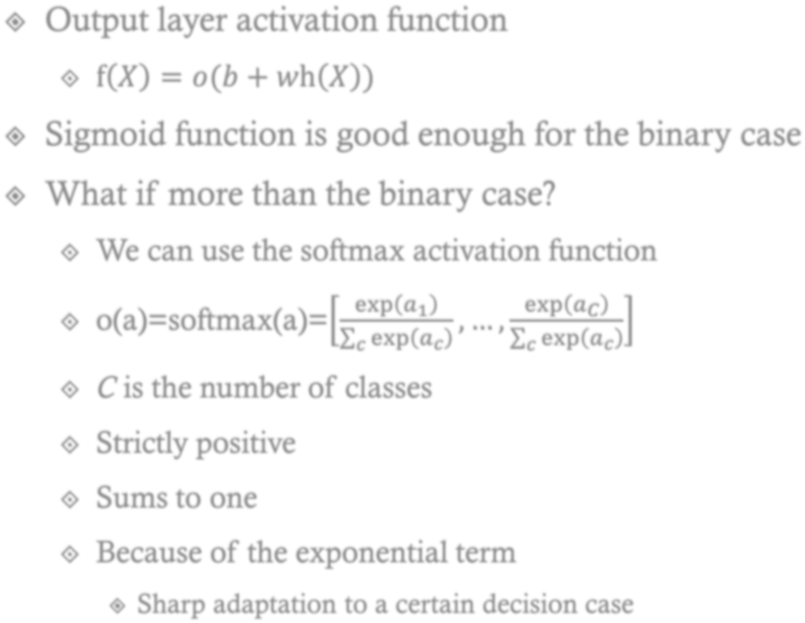















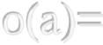

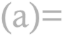
















15

Slide 17





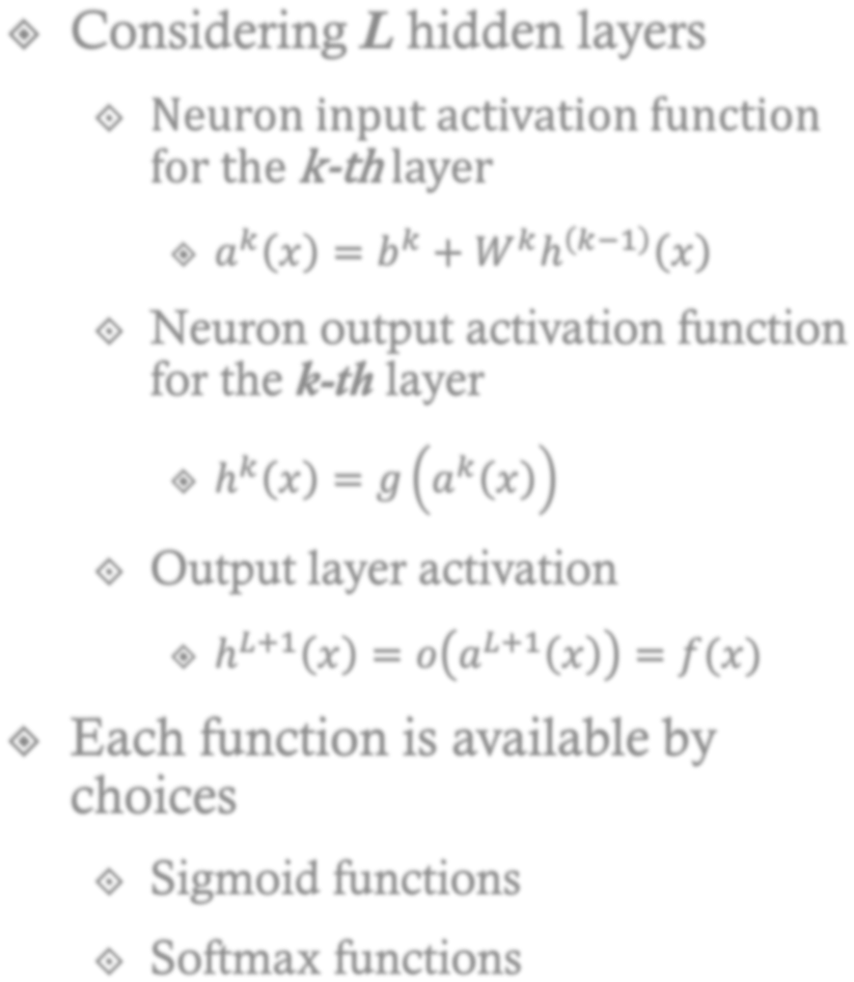

































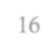
X₁
X₂
X₃
16

Slide 18






17

Slide 19
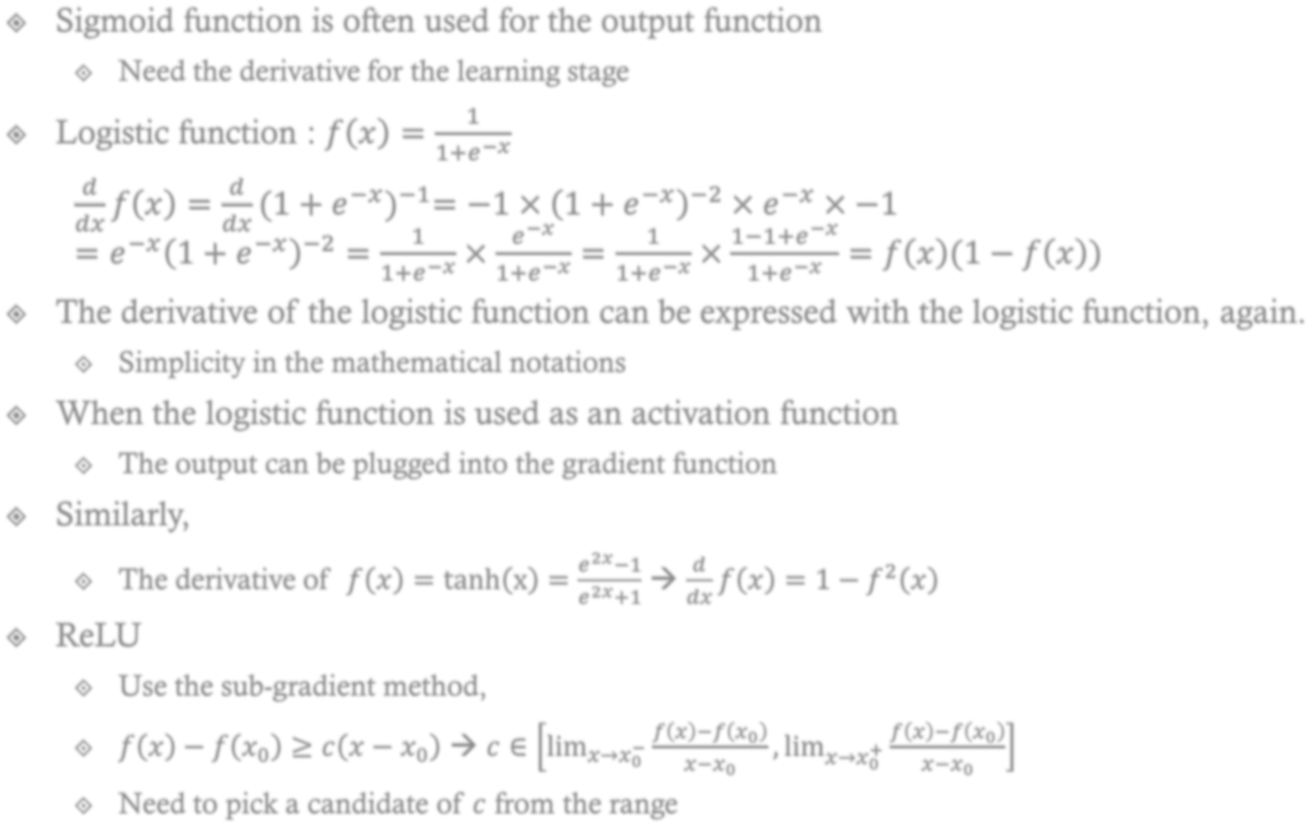




































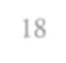

18

Slide 20

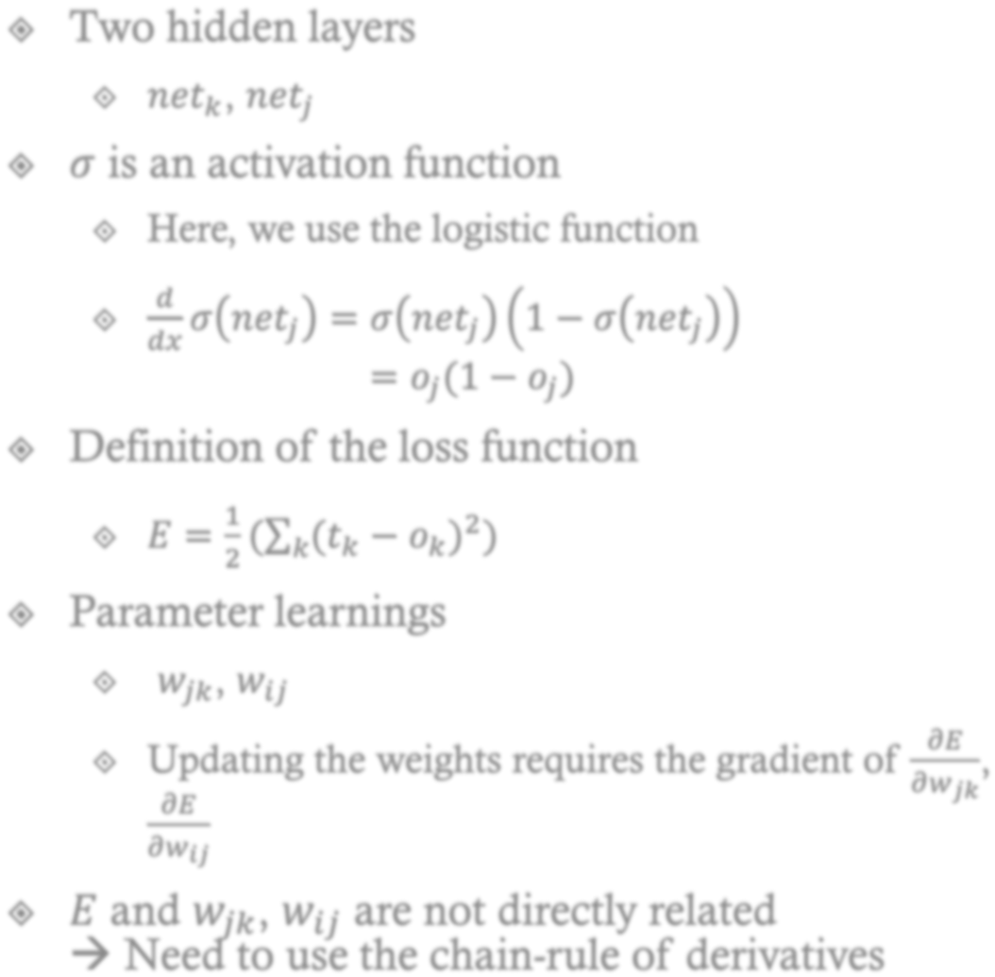

















𝑜_{𝑘}
… 𝑜… … 𝑜…
𝑜_{𝑘} = 𝜎(𝑛𝑒𝑡_{𝑘})
𝑛𝑒𝑡_{𝑘} = ෍ 𝑤_{𝑗𝑘}𝑜_{𝑗}
𝑗
^{𝑤}𝑗𝑘
𝑜_{𝑗}
…
𝑜… … 𝑜…
𝑜_{𝑗} = 𝜎(𝑛𝑒𝑡_{𝑗})
𝑛𝑒𝑡_{𝑗} = ෍ 𝑤_{𝑖𝑗}𝑜_{𝑖}
𝑖
^{𝑤}𝑖𝑗
𝑜_{𝑖}
… 𝑜… … 𝑜…
19

Slide 21


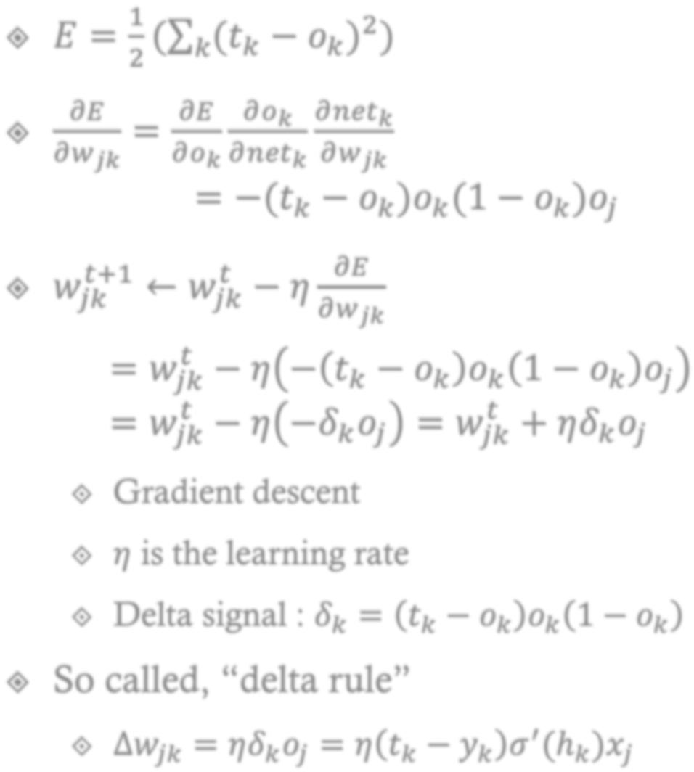




























𝒅
𝝈 𝒏𝒆𝒕_{𝒋}
𝒅𝒙
= 𝒐_{𝒋}(𝟏 − 𝒐_{𝒋})
𝑜_{𝑘}
… 𝑜… … 𝑜…
𝑜_{𝑘} = 𝜎(𝑛𝑒𝑡_{𝑘})
𝑛𝑒𝑡_{𝑘} = ෍ 𝑤_{𝑗𝑘}𝑜_{𝑗}
𝑗
^{𝑤}𝑗𝑘
𝑜_{𝑗}
…
𝑜… … 𝑜…
𝑜_{𝑗} = 𝜎(𝑛𝑒𝑡_{𝑗})
𝑛𝑒𝑡_{𝑗} = ෍ 𝑤_{𝑖𝑗}𝑜_{𝑖}
𝑖
^{𝑤}𝑖𝑗
𝑜_{𝑖}
… 𝑜…
… 20
𝑜…

Slide 22



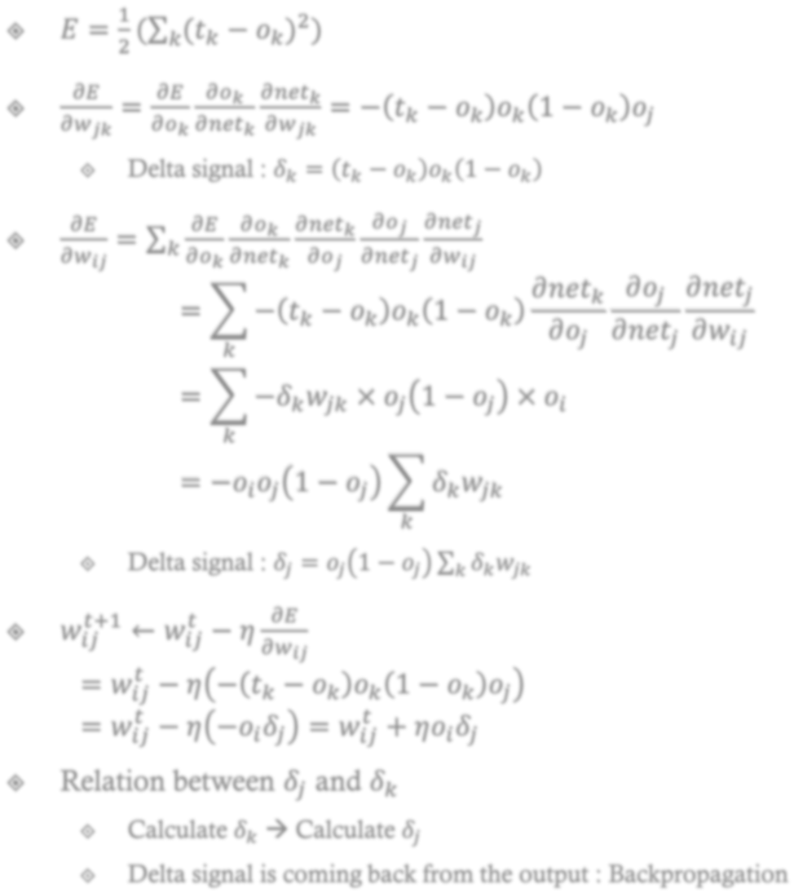























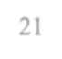
𝒅
𝝈 𝒏𝒆𝒕_{𝒋}
𝒅𝒙
= 𝒐_{𝒋}(𝟏 − 𝒐_{𝒋})
𝑜_{𝑘}
… 𝑜… … 𝑜…
𝑜_{𝑘} = 𝜎(𝑛𝑒𝑡_{𝑘})
𝑛𝑒𝑡_{𝑘} = ෍ 𝑤_{𝑗𝑘}𝑜_{𝑗}
𝑗
^{𝑤}𝑗𝑘
𝑜_{𝑗}
…
𝑜… … 𝑜…
𝑜_{𝑗} = 𝜎(𝑛𝑒𝑡_{𝑗})
𝑛𝑒𝑡_{𝑗} = ෍ 𝑤_{𝑖𝑗}𝑜_{𝑖}
𝑖
^{𝑤}𝑖𝑗
𝑜_{𝑖}
… 𝑜…
… 21
𝑜…

Slide 23



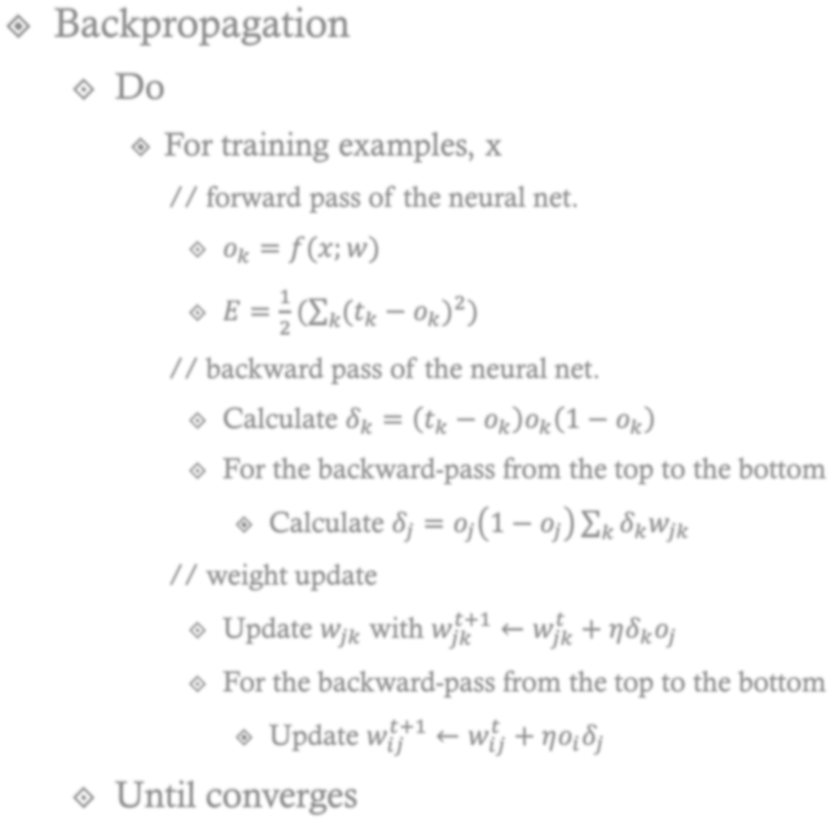
























𝑜_{𝑘}
…
𝑜…
…
𝑜…
𝑜_{𝑘} = 𝜎(𝑛𝑒𝑡_{𝑘})
𝑛𝑒𝑡_{𝑘} = ෍ 𝑤_{𝑗𝑘}𝑜_{𝑗}
𝑗
^{𝑤}𝑗𝑘
𝑜_{𝑗}
…
𝑜…
… 𝑜…
𝑜_{𝑗} = 𝜎(𝑛𝑒𝑡_{𝑗})
𝑛𝑒𝑡_{𝑗} = ෍ 𝑤_{𝑖𝑗} 𝑜_{𝑖}
𝑖
^{𝑤}𝑖𝑗
𝑜_{𝑖}
…
𝑜…
…
𝑜…
22

Slide 24
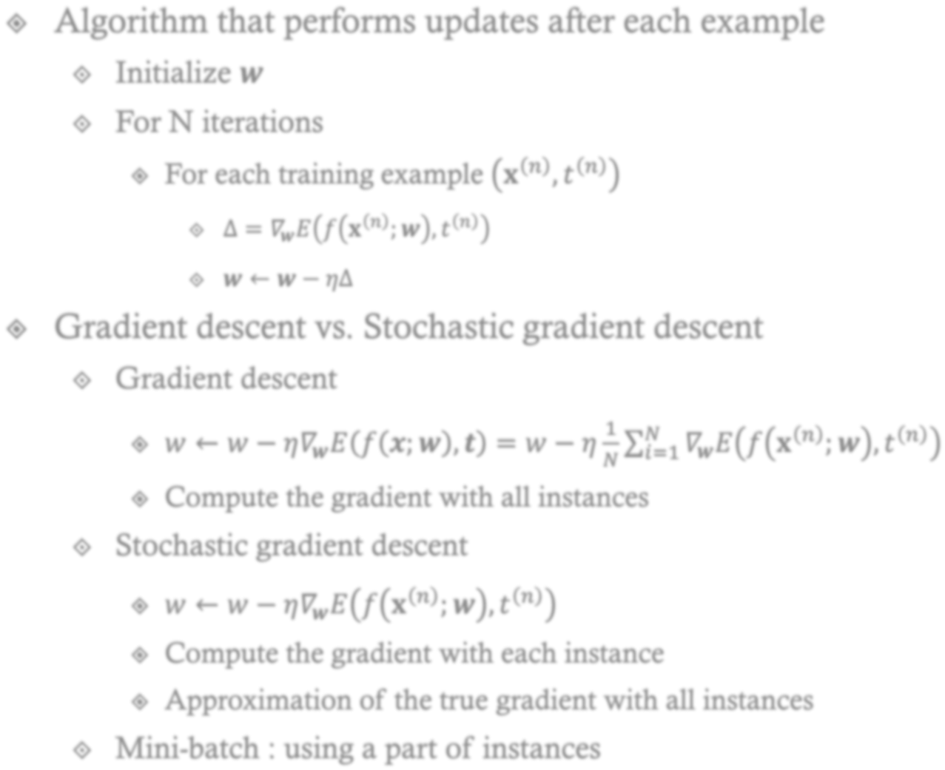

























23

Slide 25



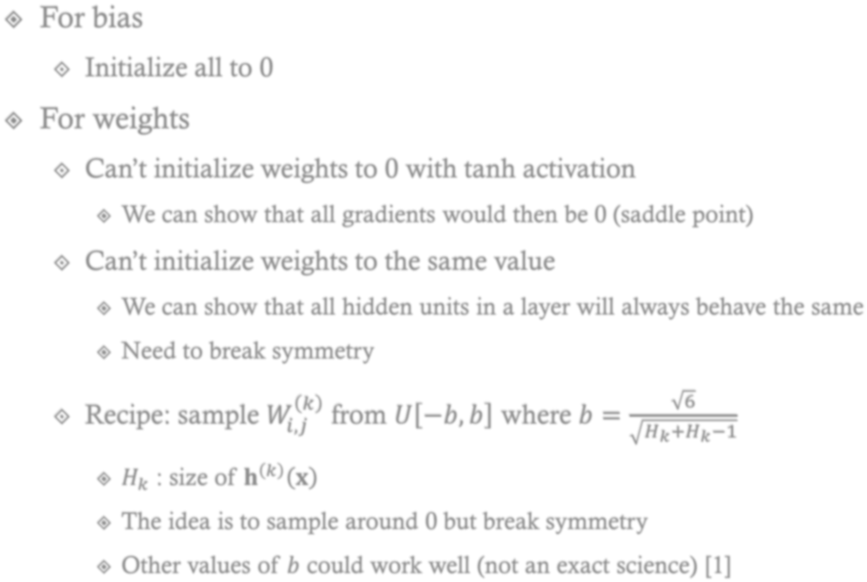































24
[1] Glorot, Xavier, and Yoshua Bengio. "Understanding the difficulty of training deep feedforward neural networks." International conference on artificial
intelligence and statistics. 2010.

Slide 26



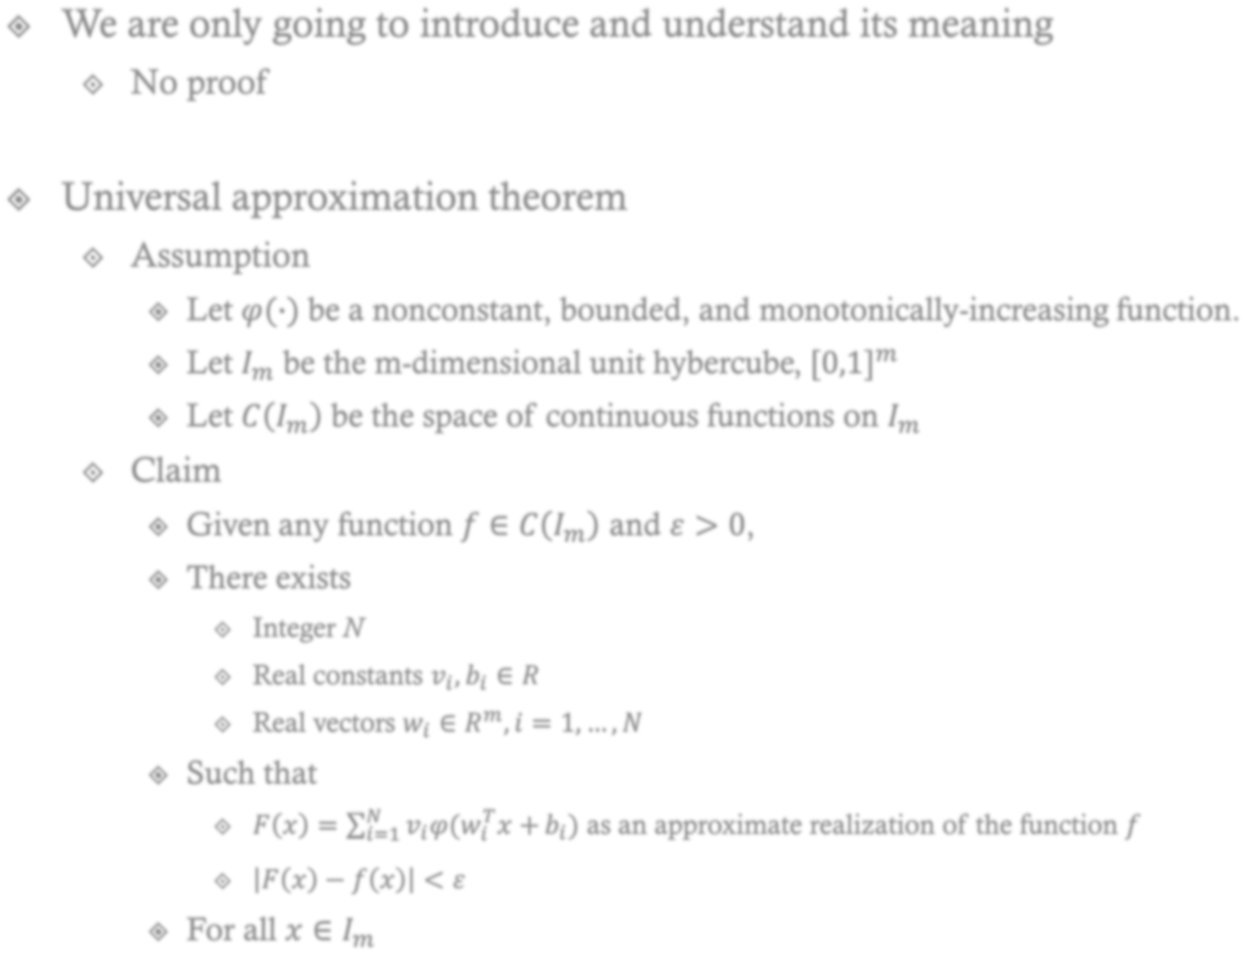

















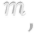








25

Slide 27
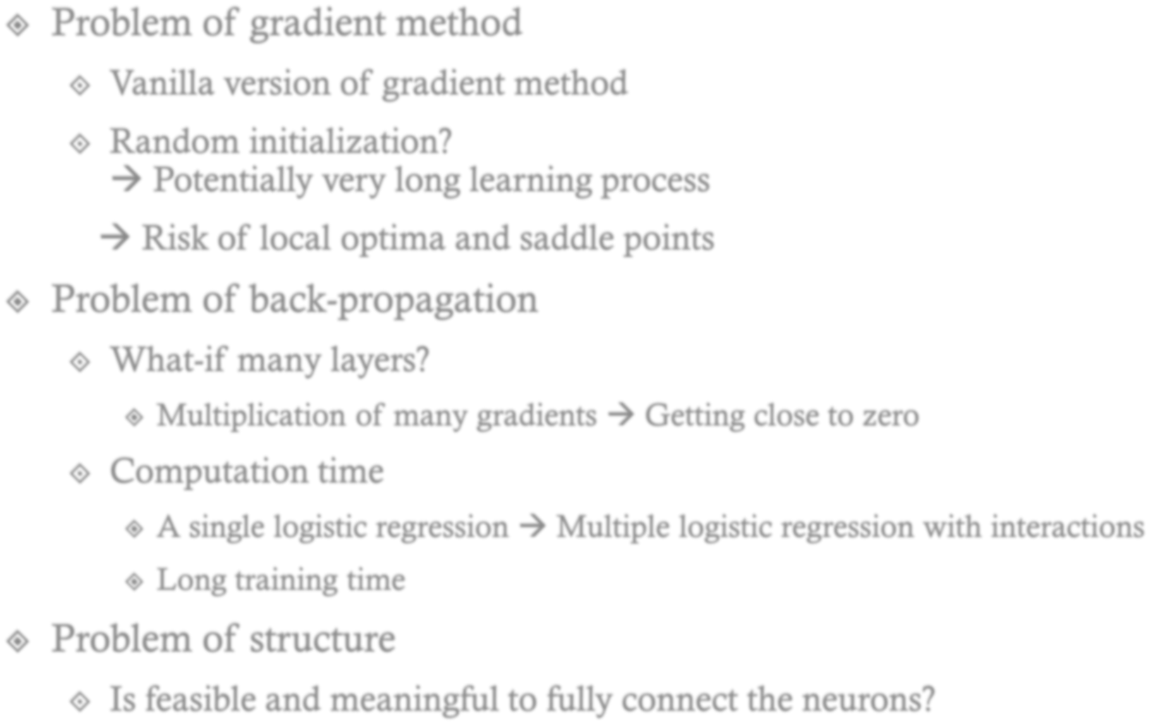






















26
LeCun, Yann, Yoshua Bengio, and Geoffrey Hinton. "Deep learning." Nature 521.7553 (2015): 436-444.

